Slide 1
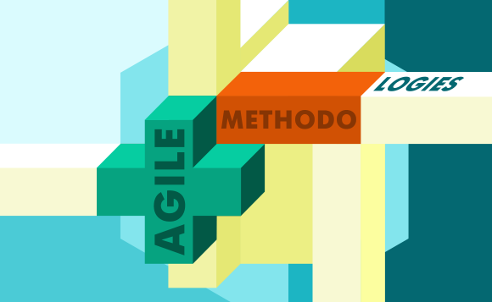
The Agile Srum-Method

Slide 2
The Product Owner
Communicates with users and stakeholders
Creates and updates user stories
Communicates to the team any changes in direction for the project

Slide 3
Plans and executes the scrum events such as the daily scrums, backlog refinements, the sprint review and sprint retrospective.
Ensures the team is working on the same page, interacting, and collaborating with each other.
Answers any of the team questions regarding agile and scrum.
The Scrum Master

Slide 4
The Developers
Develop software using the industry’s best practices
Fulfills the requirements and needs given by the product owner
Given any change in direction of the project, implement changes to meet the new requirements given by the product owner.

Slide 5
The Testers
Create clear and effective test cases to find bugs within the software.
Work with development team to discuss bugs and failed test cases
Perform frequent efficient testing

Slide 6
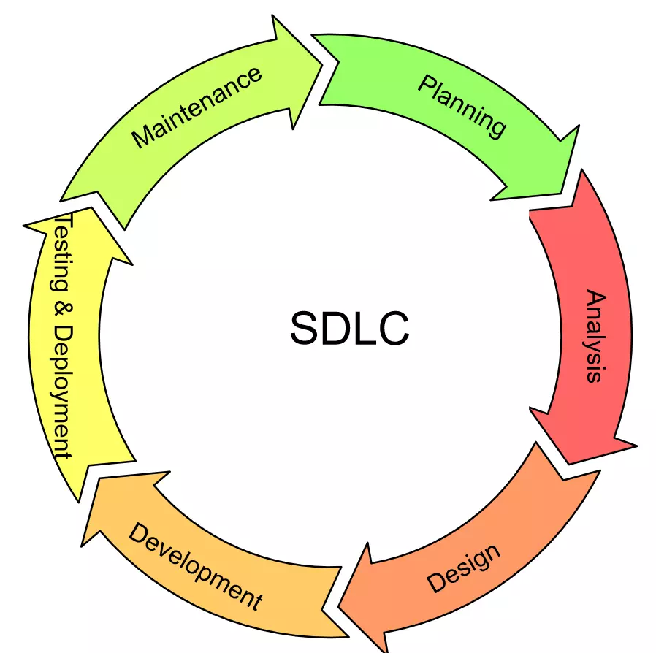
Plan
Maintenance
It’s a critical stage of the cycle. This is where stakeholders and product owner gather requirements and plan the basic project approach and logistics.
After the product is released in the market, its maintenance is done for the existing customer base.
Design
Deploy
At this stage product architects figure out the best architecture for the product to be developed with.
At this stage the product is released
formally in the appropriate market
Develop
Test
The product is developed according to the
The best industry practices and the previous
architecture designed in the design stage
At this stage, the software is tested for defects then are reported, tracked, fixed and retested, until the product reaches the quality standards

Slide 7

Waterfall Approach
In a waterfall environment we would not have been able to adapt to the new requirements of wellness and detox vacation types and stay in schedule to meet the deadline like we were able to with agile.
Due to waterfall’s linear approach, when an unexpected change happens, the projects will have to be redesigned and most of the progress is lost. Causing delays in the release date.

Slide 8
Agile or Waterfall
Waterfall method
Better estimation of operational costs
Better organized structure and straightforward
Linear structure
Non-flexible to changes
Better for straightforward projects that will not require changes.
Agile Method
Cross-functional teamwork
Flexible to changes
Incremental development
Delivers a constant working program through every sprint
Best for complex projects that will require changes

Slide 9
References
Charles G. Cobb. (2015). The Project Manager’s Guide to Mastering Agile : Principles and Practices for an Adaptive Approach. Wiley.
SDLC - Overview. Tutorials Point. (n.d.). Retrieved June 19, 2022, from https://www.tutorialspoint.com/sdlc/sdlc_overview.htm

